Slide 1
Learning together –
Prevention of Sexual Misconduct
21-24 October New York

Slide 2





What will I learn in today’s session
How to define and detect sexual misconduct
Know what is acceptable vs unacceptable behaviour and behave accordingly
Empathize with victims and put their needs first
Clarify your role, responsibilities and options for action when sexual misconduct occurs
How we can all contribute to end sexual misconduct

Slide 3

Before We Start
This is a safe space to share
Please be aware that this topic may trigger difficult and painful emotions for some people. Let’s please respect each other
You are not alone! Please make use of available staff counsellor to talk about it

Slide 4
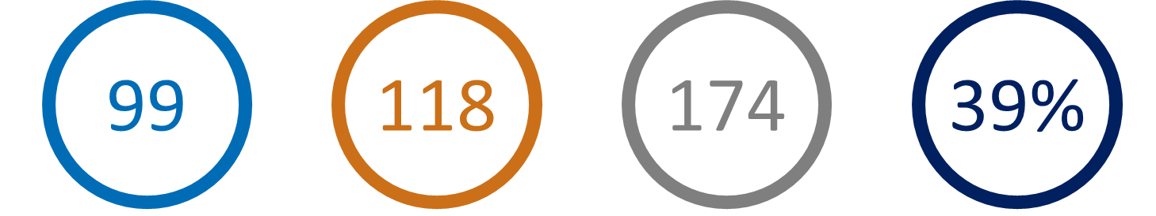
Facing the Facts – Misconduct in the UN System
1000
22
832
39%
# of Allegations in cases of Sexual Misconduct (SE, SA, SH) in the UN System since 2017*
# Reports of sexual misconduct in UNDP last year
# of identified Perpetrators in cases of Sexual Misconduct (SE, SA, SH) in the UN System in clear check*
Estimated % of UN workers that have experienced Sexual Harassment**
*Dashboard Allegations involving UN Staff Members or UN Related Personnel. Source
*Dashboard Allegations involving UN Staff Members or UN Related Personnel. Source
** Based on a two-year survey ending in November 2018. Source

Slide 5
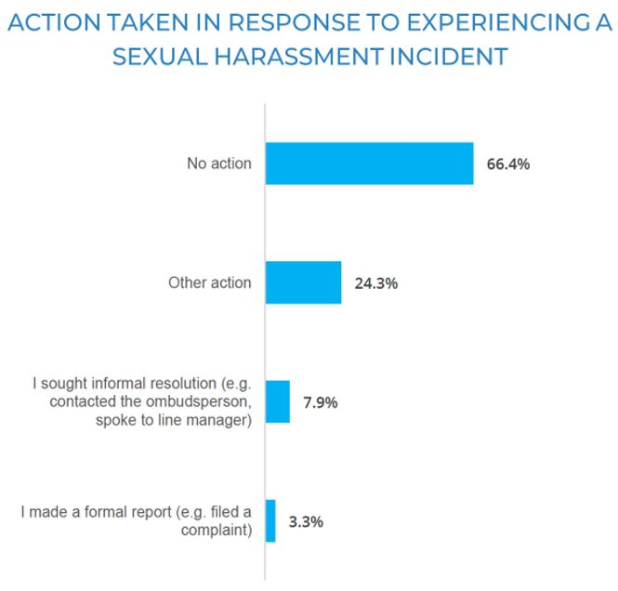
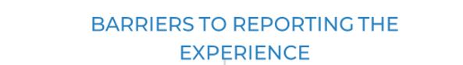
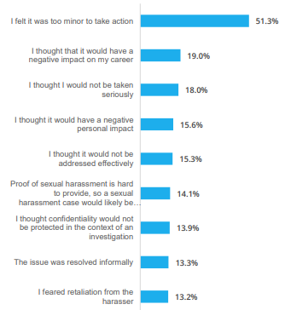
Facing the Facts – Reporting Barriers
Access Safe Space Survey Report (p.25) here
Access Safe Space Survey Report (p.26) here

Slide 6

"It can only continue in an environment that allows it to."
SG Report – reflection of 20 years
Key Point
Key Point
Key Point
Notes:
Jaqueline
As we mark the twentieth anniversary of the ST/SGB/2003/13 the SG reflected on our journey to address SEA in his latest Special Measures report.
"…the allegations were indicative of a systemic problem and coordination failures."

Slide 7

What will we cover?
group exercise
Refresher – key rules
my sphere of influence
What are you going to change starting today?
confidentiality – mutual respect – active participation – solutions thinking

Slide 8

Group Exercise
Discuss your thoughts on problem and solutions
  tap on your experiences
  think about all stakeholders
  reflect on your role, responsibilities, duties
Refrain from judgement ​ ​
Expert panel will provide feedback
Key Point
Key Point
Key Point

Slide 9
One day, you attend a donor meeting where the donor informs you of a serious allegation of sexual misconduct against a UNDP staff member involved in a project funded by the donor. The UNDP staff member is being accused of buying sex from minors, resulting in at least one pregnancy. The donor expresses great concern and indicates they may withhold further funding until the staff member is dismissed. You are aware that sex work is legal in the country where the allegation originated.
What do you communicate to the donor?
What actions should be taken at the country office level
and HQ level?
Scenario 1

Slide 10
Main points (scenario 1)
Response to donor:
Transparency with the donor is essential. Clarify UNDP’s process for handling investigations and emphasize the commitment to transparency and timely action throughout the process.
Actions at country office level:
Report to OAI immediately.
Ensure that victim assistance is a top priority, regardless of whether the allegation is substantiated or not.
Ensure safety of alleged perpetrator.
Remember, illegality or legality of prostitution does not matter.
Actions at HQ level:
OAI to inform most senior UN official in country (done in close collaboration with RR).
Support CO on managing public messaging and media inquiries related to the case. Important to mitigate reputational damage, while upholding transparency and accountability.

Slide 11
Scenario 2
You’ve recently started a new role in New York as the deputy in a team. You notice a tense atmosphere in the office: colleagues seem fearful of the director, avoid speaking up in public, and often leave early. After reviewing data from HR, you discover that ten women have resigned since the director took on his role. You’ve also observed that the director frequently comments on women’s appearances, and at a recent event, he openly referred to his assistant as ‘hot.’ Despite these behaviors, the director has been successful in raising significant funds and has a close relationship with the head of the bureau.
What do you do?

Slide 12
Main points (scenario 2)
Contact OAI, OAI might have cases already and this might add to them.​
Contact ExO for support and to see what could be done at HQ level with bureau director.​
Look into getting a respectful workplace facilitator.
Keep a detailed record of the inappropriate comments or behaviors (dates, locations, witnesses) and the list of women that resigned. ​
Put in place an exit survey for staff leaving.
If possible, speak up when the director makes these comments.

Slide 13
Scenario 3
On a Friday afternoon you are invited to a social event in a bar near the office. You see many other senior staff in the bar drinking a lot and buying drinks for JPOs and other junior staff. The bar is full and people are standing close to each other. You have heard rumors of colleagues getting intimate in and after these Friday afternoon drinks .At some point a young staff member in your office buys you a drink and asks you if you like to go to a quieter place to talk more.
What do you do?

Slide 14
Main points (scenario 3)
Maintain professional boundaries – politely suggest to speak among other colleagues or at the office during office hours.
Acknowledge that as a senior leader, you have a heightened ethical and moral responsibility to ensure a safe and professional environment.
Remind other senior leaders of their responsibility to model appropriate behavior - encourage mindful interactions with junior staff.
Contact ExO for advice.
Consider avoiding bars known for high-end prostitution. Remember, paying for sex is NEVER allowed, also not after working hours.
Have a friendly, yet clear, conversation with junior/vulnerable staff, about the importance of maintaining professional boundaries.
Notes:
Yanthe

Slide 15
Scenario 4
You are asked by a donor partner to co-host an event. Your team is responsible for organizing the opening ceremony, where many donors and UN officials are invited. The ceremony is a success, and you believe the donor will commit additional funds as a result. However, the following day, the program manager tells you that one of her staff members was sexually harassed by the deputy ambassador of the donor country during the event.
You speak to some colleagues to learn more about the staff member involved, and they describe him as a 'troublemaker' and 'promiscuous.' Shortly afterward, the staff member stops coming to work. A week later, you receive written confirmation that the donor will provide the extra funding.
Do you consider this case closed?

Slide 16
Main points (scenario 4)
You have to act - personal judgments must never influence how allegations are addressed.
Ensure the victim is safe and suggest support.
Inform OAI and ask for advice. OAI cannot investigate donors, but they can advise on what’s best.
Speak to ExO about how best to handle this situation
Don’t repeat the words "troublemaker" or "promiscuous", this devaluates the victim and further feeds into stereo types.

Slide 17



What is sexual misconduct?
Sexual Harassment
Sexual Exploitation and Abuse
Notes:
When we say ”sexual misconduct” we refer to sexual harassment AND sexual exploitation and abuse. What do you think the difference is between the two? The key difference between SEA and SH is the victim: in the case of SH the victim is a fellow worker, whether working with UNDP or with another agency or partner organization. In the case of SEA, the victim is a recipient of assistance or a member of the local community.

Slide 18
What are the key rules?
Sexual Harassment | Sexual Exploitation and Abuse
Repeated requests for a date Obscene text or video messages Using unwelcome names like honey, doll.. Pattern of conduct with sexual overtone Unwanted touching, patting, hugging Having a romantic relationship with someone you work with is discouraged Remember – it's about impact, not intention! | No sexual activity with a child (a person under the age of 18) No exchange of money, food, employment, goods, assistance, or services for sex or sexual favours No sex with sex workers No use of a child or adult to procure sex
Policy
Policy
Notes:
Jaqueline

Slide 19



Bystander intervention matters!
Harasser
Victim

Slide 20
Do and don’t-s
Do | Don’t
Keep eyes and ears open When in doubt contact OAI and Ethics Office Keep information confidential Provide information on services available to victims (link) Encourage CO leadership to regularly with the PSEAH focal point Allocate budget to PSEAH (for i.e. comms, helplines and training) Be active on PSEAH in the UNCT/HCT and contribute to inter agency initiatives Be a champion in the victim centred approach (link) Take into account your own mental health Show exemplary integrity and empathy | Investigate cases yourself Say things as ‘are you sure that happened?’, ‘but he is a good guy’, ‘that never happened to me’, ’what were you wearing’ etc. Take decisions for victims without their consent Disclose information from victims without first contacting OAI Judge /make assumptions Refer cases of serious harassment, assault or exploitation and abuse to the Ombuds office (only to OAI) Blame the victim
Notes:
Jaqueline

Slide 21

Some take-aways…
As a senior manager you have a heightened responsibility and obligation to make a difference
When in doubt report!
Most problems will not have a clear solution
Your (in)action will influence the situation
  enable the oppressor
  protect the victim
Document as much as possible
Continue the conversation
Know you are not alone
With great power comes great responsibility and great ignorance
Its not just about your responsibility to the organization, but to another human being
Changing the situation starts with individual actions
Notes:
Yanthe

Slide 22
my sphere of influence
What are we going to do starting TODAY?
Notes:
Yanthe

Slide 23
Notes:
Yanthe
Here I can create a SLIDO for you

Slide 24
Key Resources
Want to report sexual misconduct? Click here
Want to learn more about what happens when you report sexual misconduct? Listen to this podcast!
Are you a witness or bystander? Here is what you can do!
For managers – what do you do if someone reports sexual harassment to you? Click here for a quick guide
Are you the PSEAH focal point? Join the Teams community!
Do you have more questions? Study our FAQs in EN, FR, SP or visit our intranet site here
Key Point

Slide 25
Key Contacts
All information and links regarding prevention of sexual misconduct are here. All information you share is confidential:
Call us: Sam +1917225 6733 and Yanthe +31622025517 and Khaliunaa +16467814176
Ethics office ethicsoffice@undp.org for whenever you don’t know what’s right, or are afraid of retaliation
Ombudspersons office if you want help with informally solving conflicts
Code of Ethics if you want to read up on what is right and where to go when and all contact info here
Investigations reportmisconduct@undp.org as well as online or per phone if you want to report something for yourself or you are a witness
Staff counsellors if you need someone to talk to. They speak all UN languages oshw.focalpoint@undp.org or here
All questions or just to have a chat with expert: pseah@undp.org
All information can also be found in the interactive Teams space and intranet here
Key Point

Slide 26
What CANNOT be said on specific allegations
Never announce the name of the victim(s) or witnesses or other identifiable information
If victim assistance is provided, don’t give specifics on the location or provider
Never announce the name, position or location of alleged perpetrator
Don’t give information about investigations or judicial process before completed
Key Point

Slide 27
What CAN be said on specific allegations
Nature of allegation(s)
Date of alleged incident and date of complaint
Age, gender and number of victims
Assistance provided to a victim(s)
Whether matter has been referred to competent investigation entity; investigation opened, and entity conducting it
UNDP is only responsible for communicating on allegations against UNDP personnel (no other agency staff)
Coordinate closely with the RC, who should be equipped to speak effectively on allegations against any UN personnel in the country.
Key Point

